Slide 1
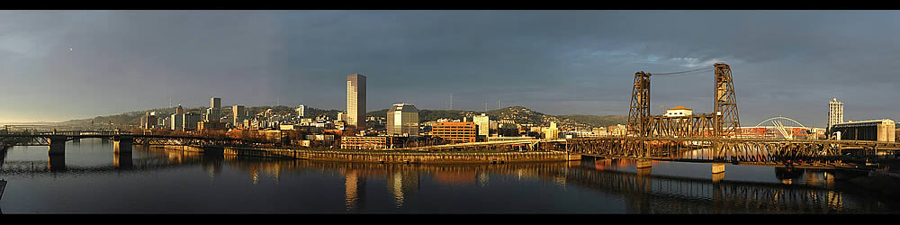

Northwest River Forecast Center
Seasonal Volume Outlook
Using Ensemble Streamflow Prediction
for the 2012 Water Year
Steve King, Sr. Hydrologist
Northwest River Forecast Center
Stephen.King@noaa.gov
Notes:
2006 Spring Outlook
< READ SLIDE >

Slide 2
2011 Runoff Summary
April – September Flow Volumes
(percent of normal and rank)
Skagit: 111 10/41
Cowlitz: 144 4/41
Willamette: 145 3/41
Rogue: 154 1/41
John Day: 220 1/41
Mica: 99 23/51
Libby: 133 10/51
Hungry Horse: 161 1/41
Dworshak: 152 5/44
Palisades: 151 2/41
Lucky Peak: 128 11/42
Lower Granite: 151 4/51
Grande Coulee: 123 5/51
The Dalles: 135 4/51
* *All forcing years weighted equally (no knowledge of La Nina

Slide 3
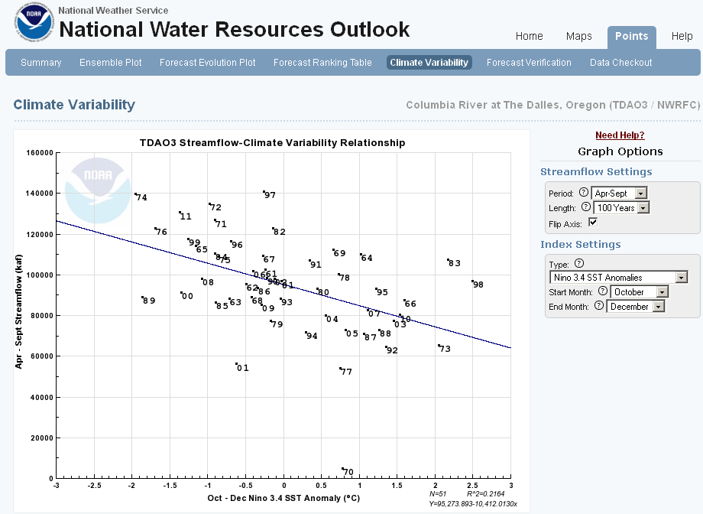
Current SST = -0.7
FCST OND SST ~ -.3 and -1.3
La Nina Neutral El Nino

Slide 4
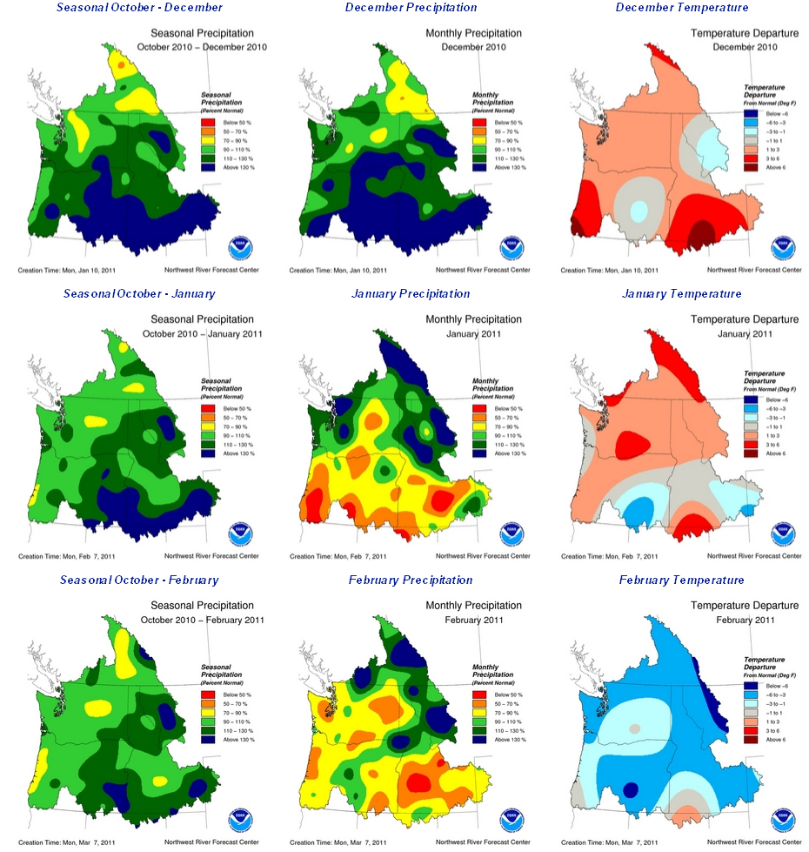
WY 2011 Winter Climate
Seasonal Precip Monthly Precip Monthly Temp
Dec
Jan
Feb
Notes:
Intro
KB – NWRFC
talk about the 2006 seasonal volume fx

Slide 5
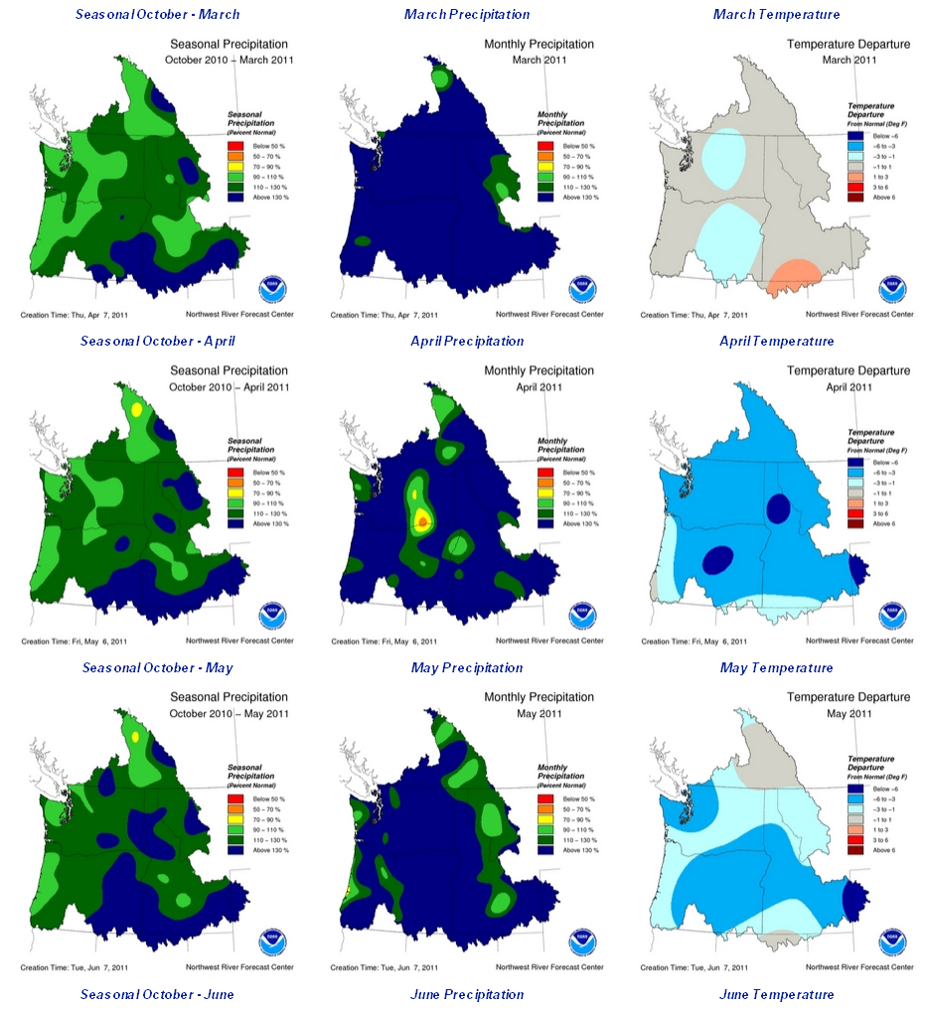
WY 2011 Spring Climate
Seasonal Precip Monthly Precip Monthly Temp
Mar
Apr
May
Notes:
Intro
KB – NWRFC
talk about the 2006 seasonal volume fx

Slide 6
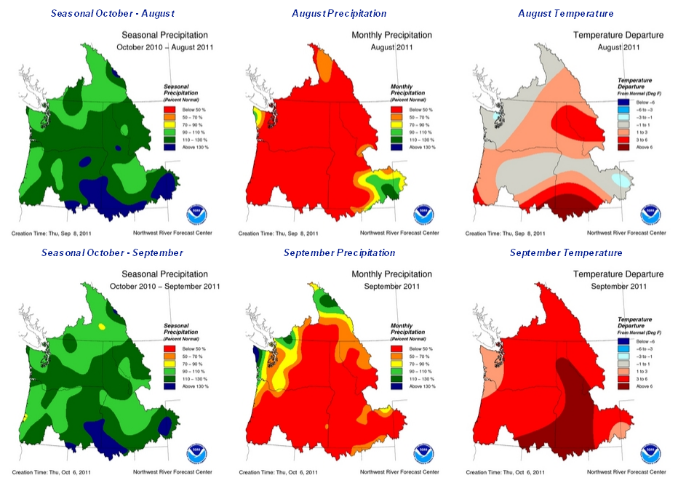
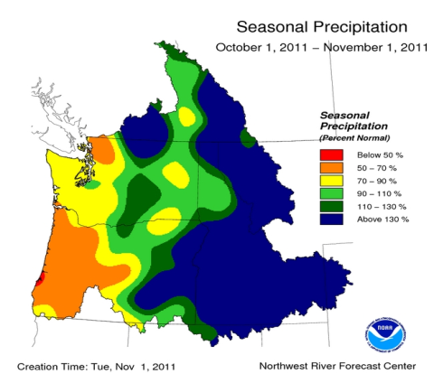

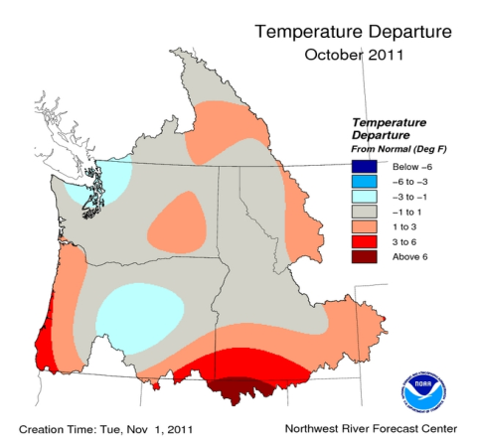
WY 2011 Summer Climate
Seasonal Precip Monthly Precip Monthly Temp
Aug
Sep
WY 2012
Oct
Notes:
Intro
KB – NWRFC
talk about the 2006 seasonal volume fx

Slide 7

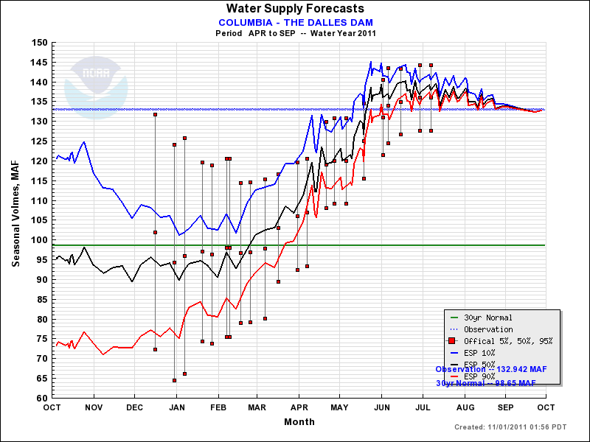
Verification

Slide 8

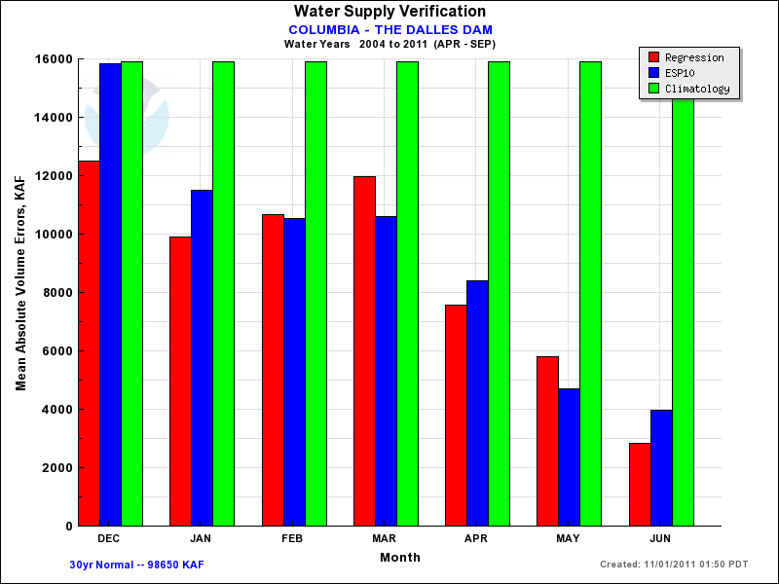
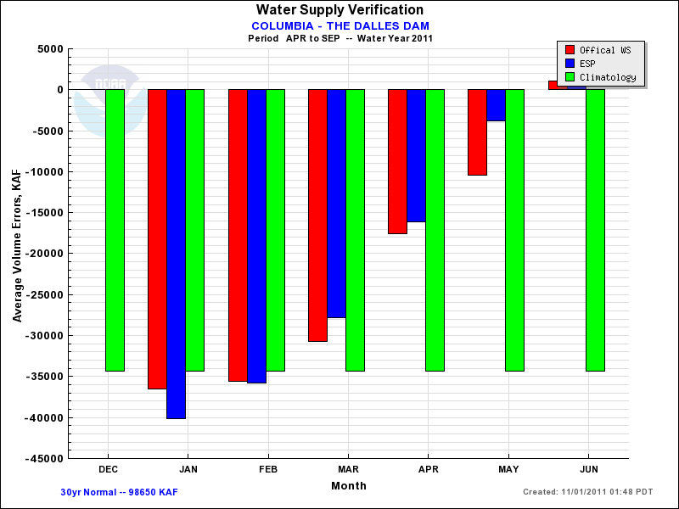
2011 Forecast Verification
http://www.nwrfc.noaa.gov/water_supply/ws_verif.cgi
Verification for 2004-2011
Verification for 2011

Slide 9
Spring 2012 Outlook
Ensemble Streamflow Prediction (ESP)
Driven by: Antecedent Snow/Soil Moisture
10 day Precip and Temp forecast
Precip and Temp climatology (1948-2003)
Capability of including climate forecasts/signals
Notes:
2006 Spring Outlook
< READ SLIDE >

Slide 10
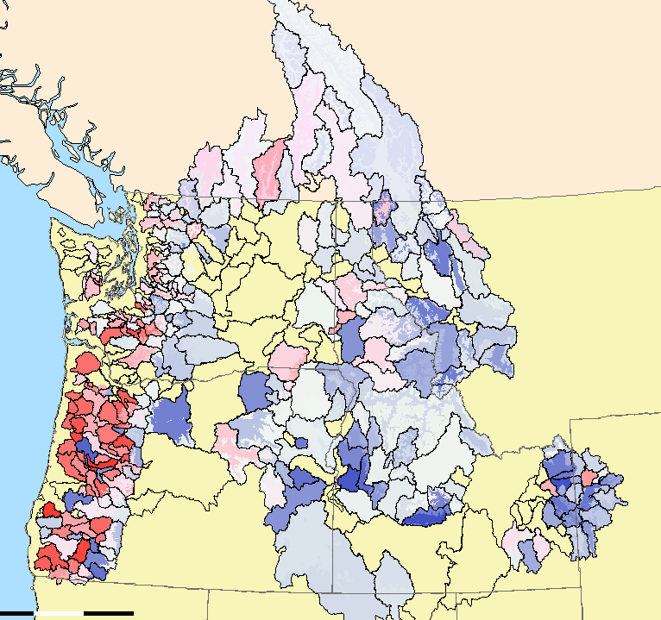
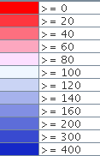
ESP: Soil States
Simulated Primary Soil Moisture
(percent of average)

Slide 11
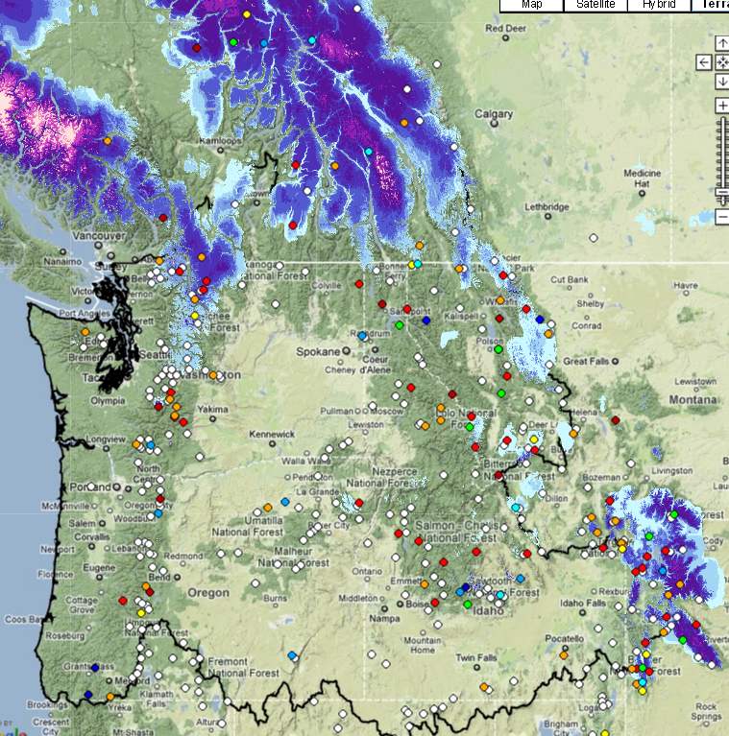
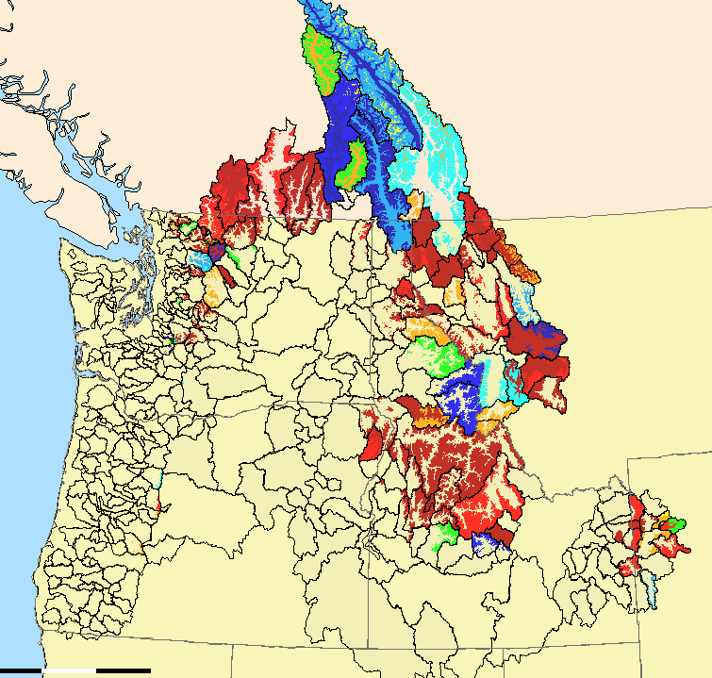
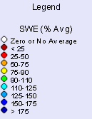
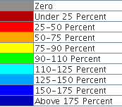
ESP: Snow Water States
Observed Snow Water Equivalent
Overlay= NOAA NOHRSC
Satellite Product
Depicting Nov 1st SWE
Simulated Basin Snow Water Equivalent
(percent of average)

Slide 12
ESP Standard Forcings
10 days of Forecast Precip and Temp, followed by 1948 Precip and Temp
10 days of Forecast Precip and Temp, followed by 1949 Precip and Temp
10 days of Forecast Precip and Temp, followed by 1950 Precip and Temp
.....
10 days of Forecast Precip and Temp, followed by 2003 Precip and Temp
‘48
……………………………………………………………………………………..
‘03
Hydro Model (NWS CHPS)
Updated to reflect current model states
(Soil Moisture, SWE)
Deterministic Flow Forecast based on 1948 Forcings
Deterministic Flow Forecast based on 1949 Forcings
Deterministic Flow Forecast based on 1950 Forcings
.....
Deterministic Flow Forecast based on 2003 Forcings

Slide 13
ESP with La Nina Forecings
10 days of Forecast Precip and Temp, followed by 1948 Precip and Temp
10 days of Forecast Precip and Temp, followed by 1949 Precip and Temp
10 days of Forecast Precip and Temp, followed by 1951 Precip and Temp
.....
10 days of Forecast Precip and Temp, followed by 2000 Precip and Temp
‘48
……………………………………………………………………………………..
‘03
Hydro Model (NWS CHPS)
Updated to reflect current model states
(Soil Moisture, SWE)
Deterministic Flow Forecast based on 1948 Forcings
Deterministic Flow Forecast based on 1949 Forcings
Deterministic Flow Forecast based on 1951 Forcings
.....
Deterministic Flow Forecast based on 2000 Forcings

Slide 14
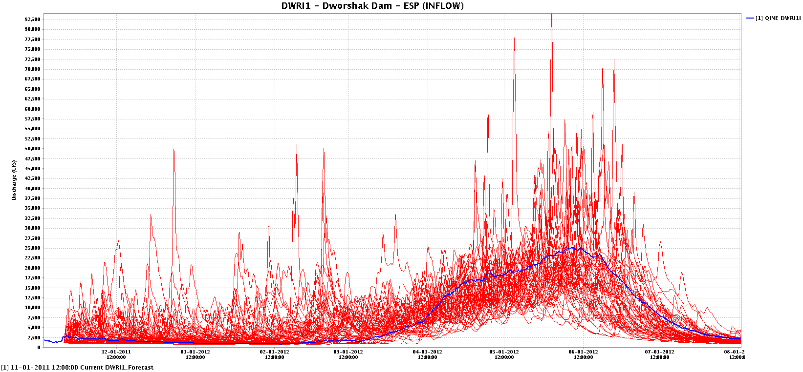
ESP Traces
Each outcome is equally likely

Slide 15
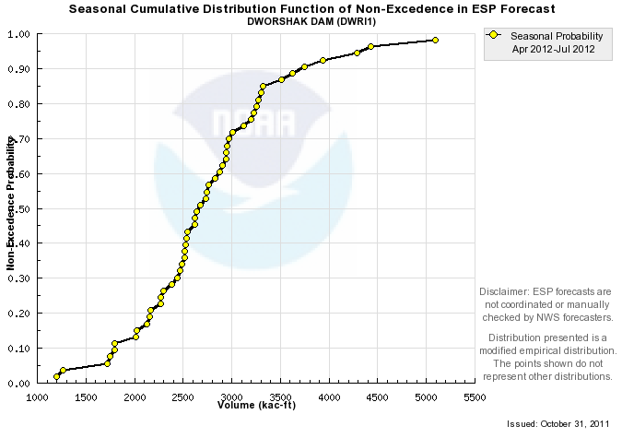
Statistical Analysis of ESP Traces
Probability of each outcome plotted
’96-97
’71-72
’76-77
’72-73

Slide 16
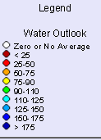
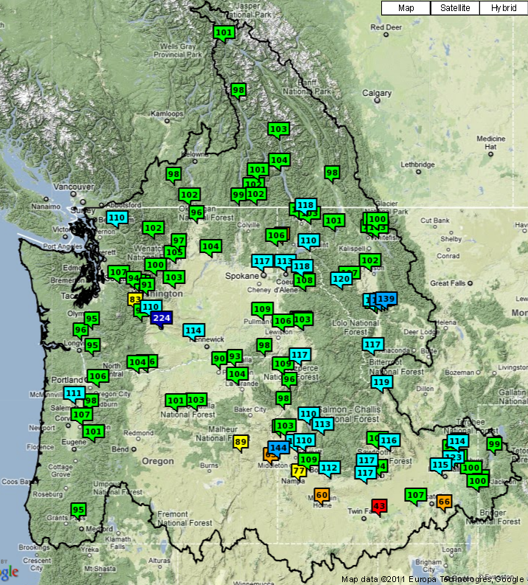
2012 ESP Outlook**
Water Supply
Apr-Sep Flow Volumes (as % of Normal)
Mica: 101
Hungry Horse: 103
Libby: 101
Dworshak: 104
Palisades: 100
Lucky Peak: 109
Skagit: 110
Willamette: 111
Rogue: 95
John Day: 101
Lower Granite: 109
Grande Coulee: 104
The Dalles: 104
* *All forcing years weighted equally (no knowledge of La Nina
* *All forcing years weighted equally (no knowledge of La Nina

Slide 17
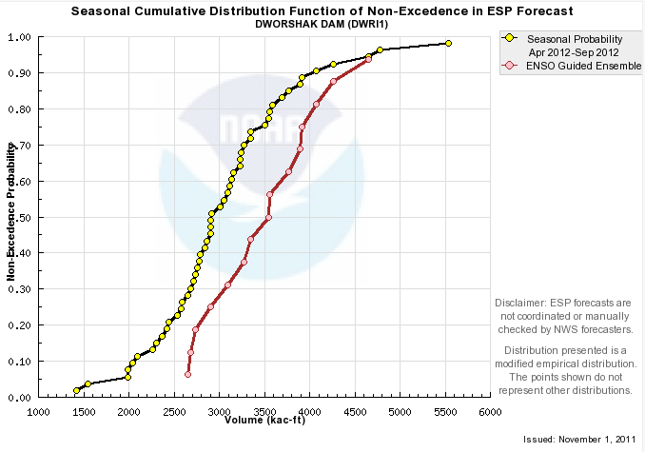
ESP: All years vs La Nina Years
ESP50.ALL= 2900 KAF
ESP50.LN = 3550 KAF
(22% larger)

Slide 18
2012 ESP Outlook Using La Nina Forcings
Water Supply Flow Volumes (Apr-Sep)
Station `48-`03 LN years
Mica: 101 106
Hungry Horse: 103 113
Libby: 101 103
Dworshak: 104 127
Palisades: 100 111
Lucky Peak: 109 125
Skagit: 110 119
Willamette: 111 118
Rogue: 95 117
John Day: 101 110
Lower Granite: 109 122
Grande Coulee: 104 109
The Dalles: 104 111
* *All forcing years weighted equally (no knowledge of La Nina

Slide 19
NWS Western Region / NWRFC Water Supply Directions
ESP is primary NWS forecast tool (replacing legacy regression model)
Volumetric forecasts issued weekly through year, with daily updates as an option.
NWS Regression Forecasts no longer published
Agency ‘Coordination’ redefined as ‘Collaboration’.

Slide 20

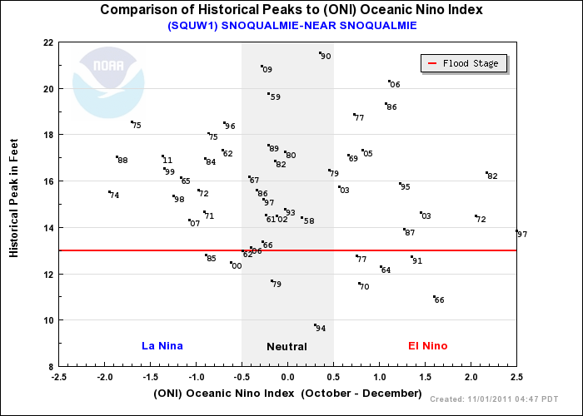
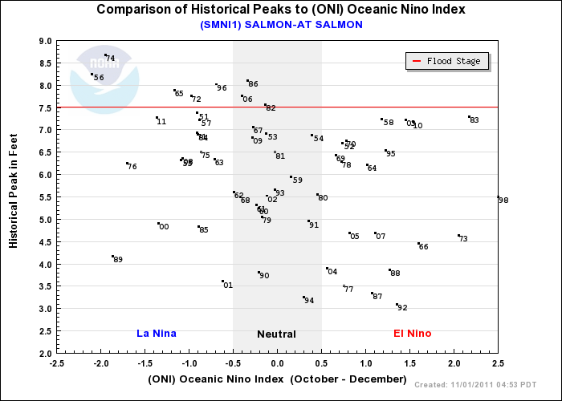

Slide 21
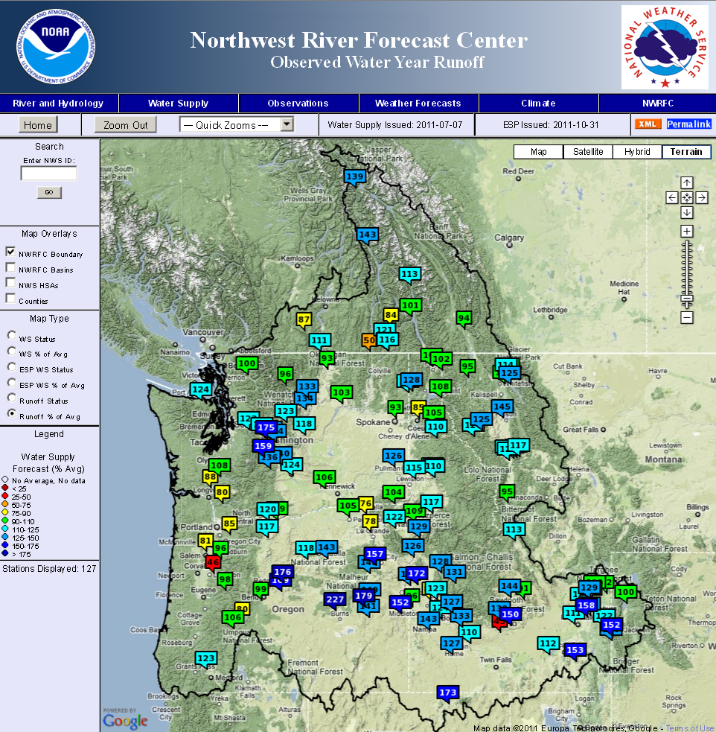
www.nwrfc.noaa.gov

